Slide 1
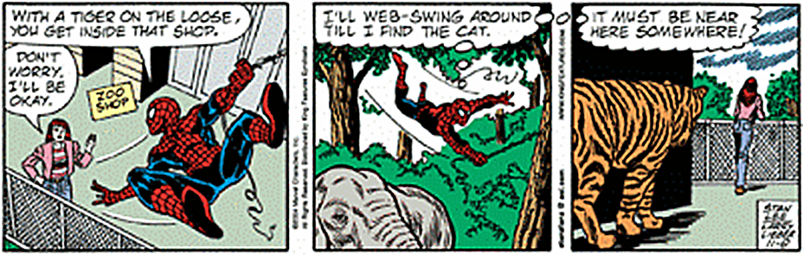
Superhero Transformations
How algorithmic thinking can help create visual stories

Slide 2
Introduction to Computational Thinking: Vocab
Abstraction: Ignoring unimportant details in something complicated In this project: Simplifying the design of your superhero with basic shapes
Decomposition: Breaking down a big problem into smaller pieces In this project: Dividing your superhero story into four comic panels
Algorithmic thinking: Creating or using a list of steps needed to complete a task In this project: Finding the series of geometric transformations between panels

Slide 3
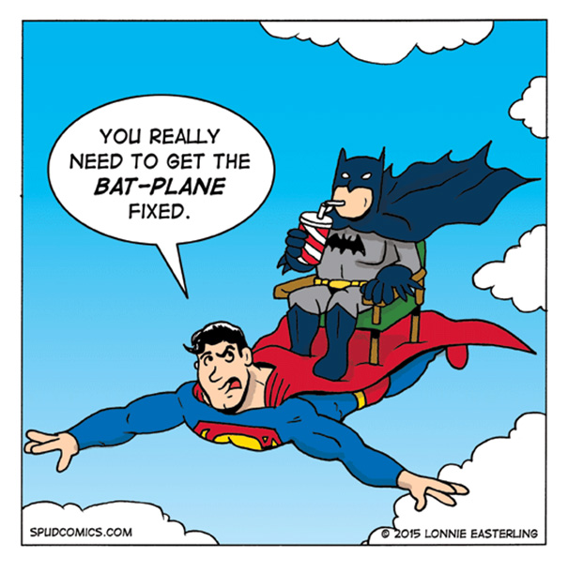
Project overview
You are going to create a superhero comic strip! To do this, you will:
Design your own superhero
Simplify your superhero using basic shapes
Write a short story about your superhero
Place your superhero in the first of four comic panels, and then use geometric transformations to get your superhero into the other three panels
Finalize your comic strip with other characters, props and scenery

Slide 4

Step 1: Create your superhero
Come up with a name and one or two superpowers
Sketch your superhero in the square provided

Slide 5
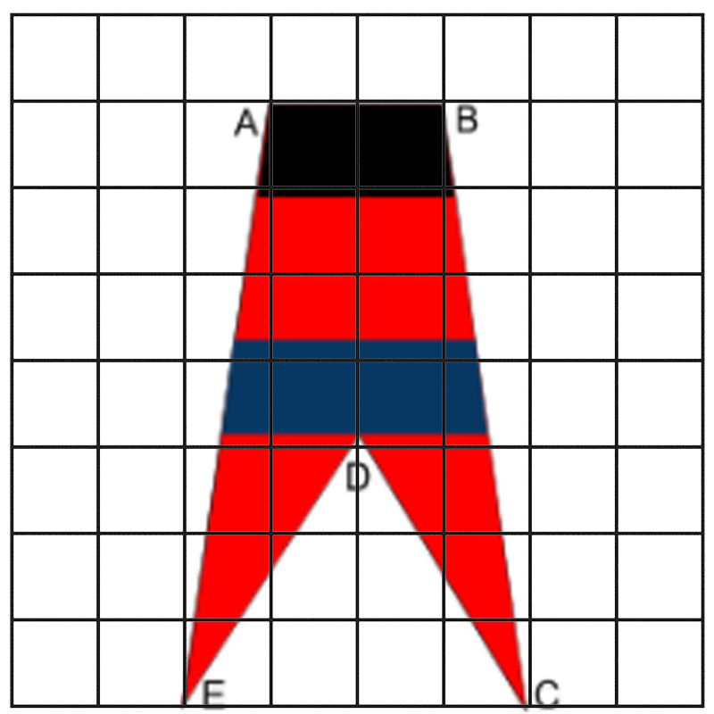
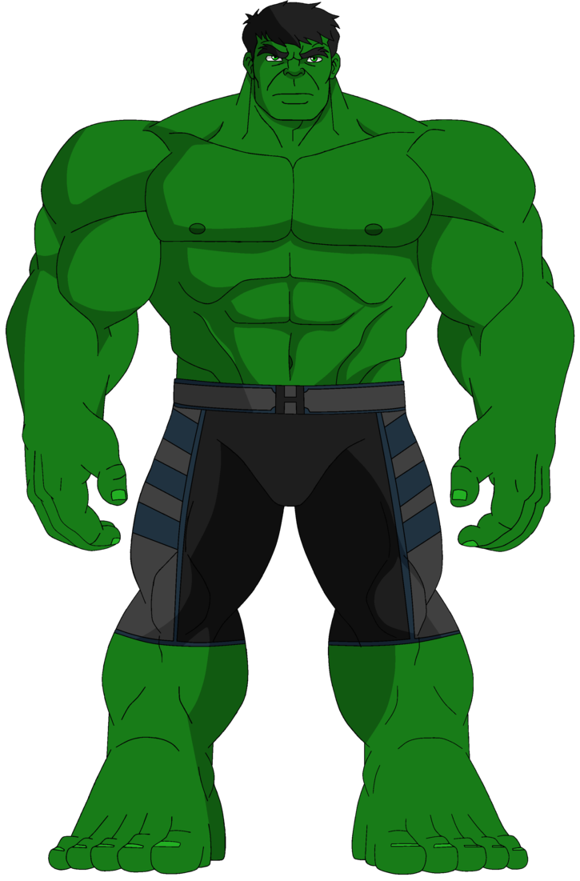
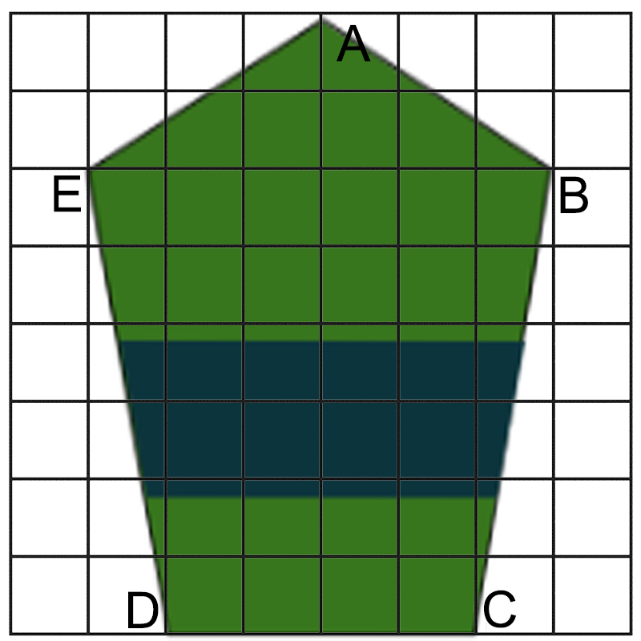
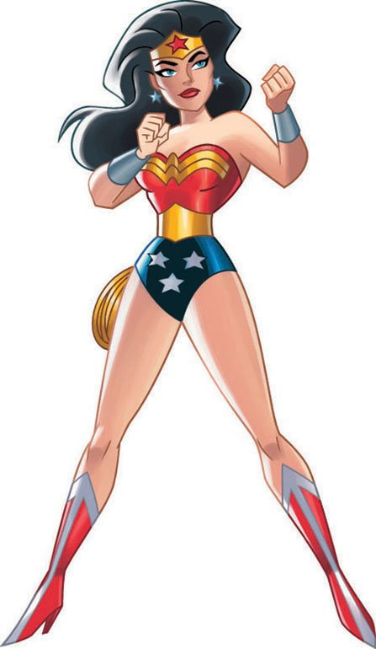
Step 2: Use abstraction to simplify your design
Recreate your superhero with a simple geometric shape with five or fewer labeled vertices. Your vertices must land on the intersection of two grid lines.

Slide 6
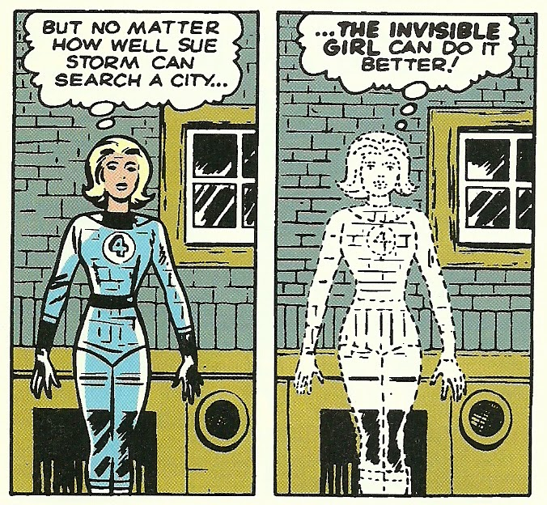
Step 3: Write your superhero story
Choose one of the following three story ideas, then write out your story in a short paragraph, at least 5 complete sentences.
The first day your superhero discovers their powers. Things get a little out of control!
A supervillain (of your own design) has kidnapped your best friend - how will your superhero free them?
An alien army is invading Tacoma - how will your superhero stop them and save the world?
Notes:
Keep in mind you only have four panels to tell your story in comic form, and don’t forget to use your hero’s superpower(s)! This does NOT mean your story is only four sentences long - you will have to pick which parts you want to highlight in the four panels you have.

Slide 7
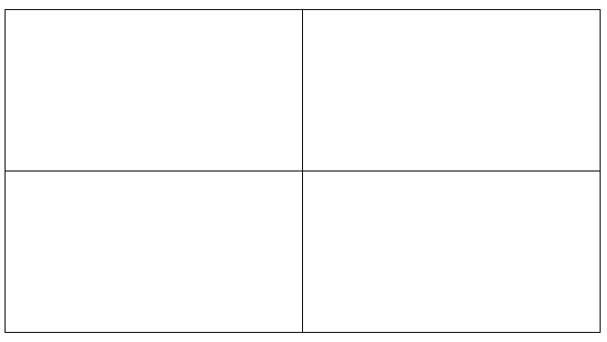
Step 4: Use decomposition to break down your story
Your story needs to be broken down into four comic panels. Each panel needs to include your superhero. Each panel can also include:
Other characters
Props and scenery
Speech or thought bubbles
Captions or sound effects

Slide 8
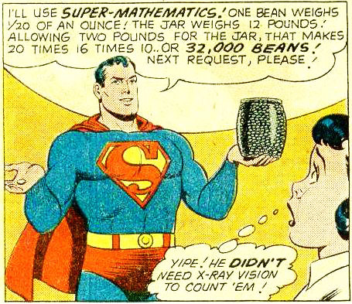
Step 5: Cut out your hero and put him or her in Panel 1
Trace your simplified hero design into the first panel, making sure your verticles land on grid lines.
Record the coordinates of each vertex on your handout

Slide 9
Step 6: Use algorithmic thinking to move your hero
For each panel, come up with one or more transformation (translation, reflection or rotation) to get your superhero where you want them in the panel.
You must use at least one reflection OR one rotation in your project
You must write your steps, including what transformation(s) you did and the coordinates of each vertex in each panel
Use the cutout to help visualize where you want your hero in each panel
Example: To get my hero from Panel 1 to Panel 2, I... | translated by 3 units in the y-direction (up) A₂: 5 , 15 B₂: 0 , 18 C₂: -5 , 13 ￼ D₂: -9 , 4 E₂: , ￼

Slide 10
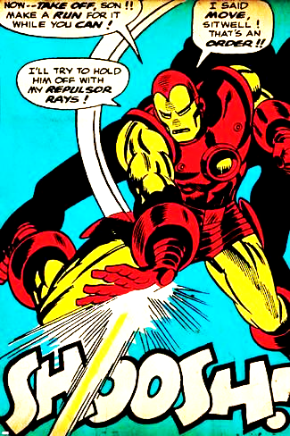
Step 7: Complete your comic!
Looking back at your story from Step 3 and your panel sketches from Step 4, fill in the remaining details in each panel. These could include:
Other characters (good guys, bad guys or innocent civilians)
Scenery (buildings, trees, cars…)
Word or thought bubbles
Captions describing what’s happening in each panel

Slide 11
Project Component | Point Value
Planning steps completed: [Step 1] Superhero name and superpowers listed [Step 2] Simplified geometric superhero drawn and cut out [Step 3] Story written in short paragraph form [Step 4] Each panel sketched with the superhero included in each [Step 5] Starting coordinates correctly identified | _______/25 (5 points per step)
Final comic panels completed | _______/12 (3 points per panel)
The steps between each panel listed in the table include: correct geometric transformations coordinates for the superhero’s vertices | _______/20 (4 points per step)
Neatness/organization/effort Handwriting is legible (able to be read) Colorful illustrations Creative illustrations Name and block are written in the correct place | ________/8 (2 points per requirement)

